Slide 3

Raimund Andree
PFE / CE / CSA / …, Microsoft Germany
DevOps, DSC, PowerShell, Automation
Projects: AutomatedLab, DscWorkshop, Microsoft365DscWorkshop
GitHub: https://github.com/raandree

Slide 4



Good programming is
+
Technical Expertise
Coding Mindset
A programmer’s three high-level goals are to write code that
Solves a specific problem
Is easy to read
Is maintainable and executable

Slide 5









Where we come from
DSC Community
PSScriptAnalyzer
Sampler
Pester
ISE
PowerGui
The Scripting Guy
Using PowerShell like VBS
Azure Pipelines

Slide 6
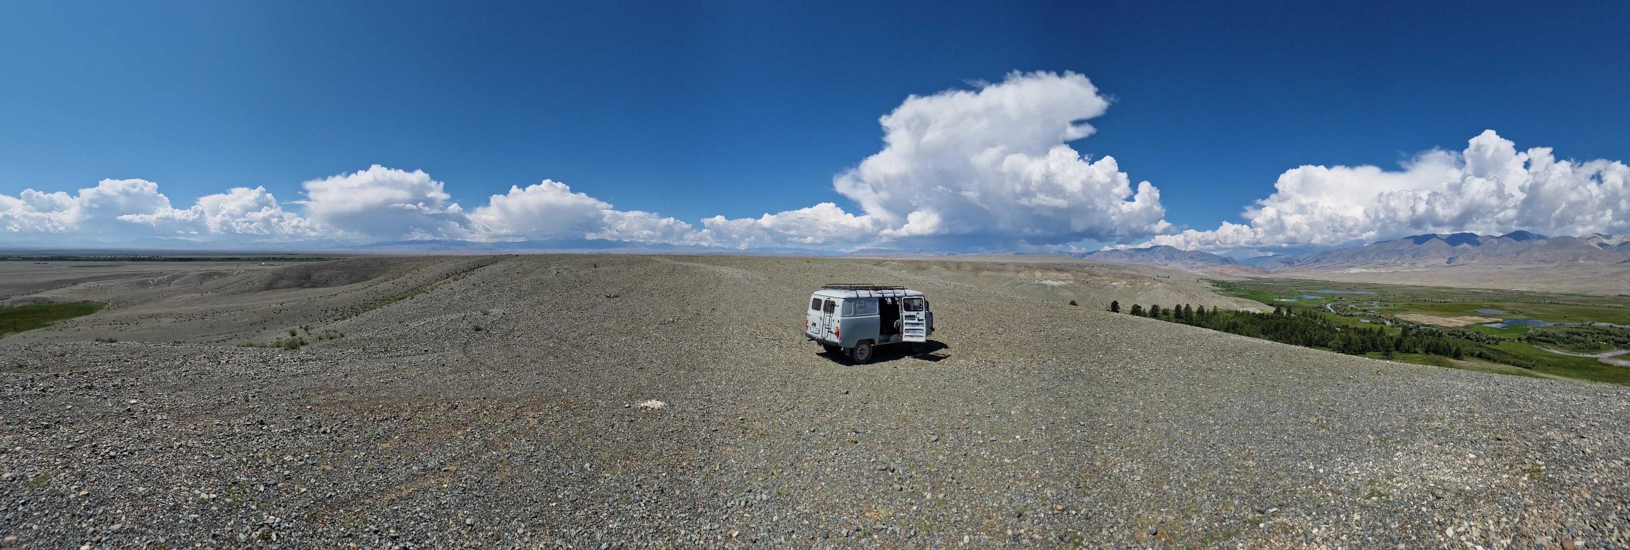

Why rules and guidelines?

Slide 7
Coding Best Practices
Portability
Automated Testing
Rich Data Structures
Modular
Camel case
Pascal case
Reusability
Scalability
Style / Indentation
Naming Convention

Slide 8
PowerShell Language Features
Instrumentation
Profiling
Custom Objects
Splatting
Regular Expressions
Classes
CmdletBinding
Linting
PSScriptAnalyzer
Variables
Pester
Modules
Functions
Pipeline Support
SupportsShouldProcess
Parameters
Mandatory
Pipeline Support
Validation
Parameter Sets
System Variables
Comment-Based Help
Configuration
Flow Control
(Cyclomatic Complexity)
Git

Slide 9
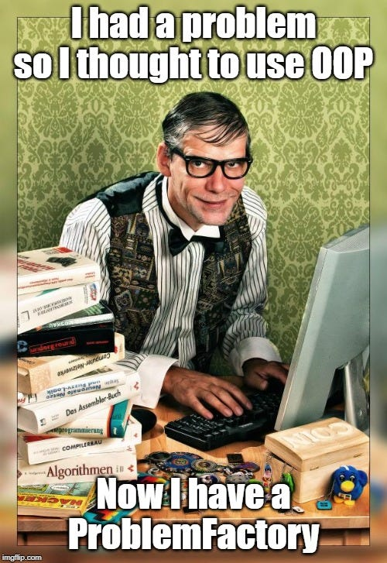
Not every pattern is the right one
Some people, when confronted with a problem, think "I know, I'll use regular expressions." Now they have two problems.
Using PowerShell Classes the
wrong way may result in:

Slide 10
Demos
We love Demos!

Slide 11
References
raandree/PowerShellTraining (github.com)
PoshCode/PowerShellPracticeAndStyle: The Unofficial PowerShell Best Practices and Style Guide (github.com)
Style Guidelines (dsccommunity.org)
gaelcolas/Sampler: Module template with build pipeline and examples, including DSC elements. (github.com)

Slide 12
Q&A
15 minutes

